Slide 1
Advancing Data Literacy: Senior Manager Training for M4s
Kevin Hanegan

Slide 2
Introduction
Kevin Hanegan
Pioneer and Thought Leader in Data Literacy
Author of Turning Data into Wisdom and Data Literacy in Practice
Chair of The Data Literacy Project
Founder of Turning Data into Wisdom
30+ Years of experience in Data & Analytics, Enterprise Learning
and Organizational Change Management.
Former Chief Learning Officer at Qlik
Professor at Boise State University
Professor at Oregon State University

Slide 3
Learning Objectives
Apply a data-informed decision-making process
To transform complex business problems into actionable insights
Evaluate data quality and insights
Using the six key validation criteria to minimize decision-making biases and avoid common analytical fallacies
Demonstrate systems thinking
Identifying and analyzing multiple layers of a problem to develop more comprehensive solutions
Apply analytical thinking characteristics
Systematically break down business problems and generate data-informed recommendations

Slide 4
Agenda & Timings
Topic | Estimated Timing
Introductions | 09:00 – 09:10
Data-Informed Decision-Making Process – Part 1 | 09:10 – 09:30
BREAKOUT ACTIVITY | 09:30 – 09:50
Breakout Recap | 09:50 – 10:00
QUICK BREAK | 10:00 – 10:05
Data-Informed Decision-Making Process – Part 2 | 10:05 – 10:35
Key Takeaways | 10:35 – 10:45
Open Q&A | 10:45 – 11:00

Slide 5
Data-Informed Decision-Making Process
Monitor & Evaluate
Ask & Define
Evaluating decisions made. Monitor and adjust as needed.
Identify decisions to be made
?
Capture & Acquire
Implement & Act
Understand and acquire relevant data
Start change management efforts
Analyze & Transform
Announce & Market
Transform data into insights
Communicate decisions and start change management efforts
Resolve & Decide
Validate & Verify
Transform insights into decisions
Validate the insights

Slide 6
The 4 Thinking Types for Informed Decision-Making
Analytical Thinking
Critical Thinking
Creative Thinking
Decision-Making
ANALYZE
EVALUATE
CREATE
ACT
What do I know?
What does it mean?
What can I do with this?
What should I do?
Insight
Validation
Innovation
Decision
Systems Thinking

Slide 7
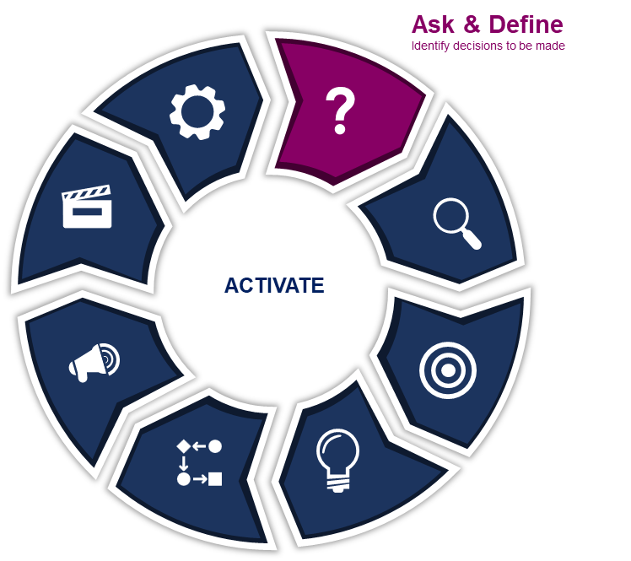
Define the Problem/Question and Decision to be Made
Define the Problem / Decision
Motive, Context, Success measures, and Boundary Conditions
Classify the Problem / Decision
Complexity, Risk, Uncertainty, Time, Impact, Reversibility, Frequency
Convert to Data Questions
Convert Business Questions to Data Questions

Slide 8
Define the Problem/Decision
Identify the Problem
Describe the Decision
Define Success Measures
What is the problem we are trying to solve or situation we are trying to improve?
What is the decision to be made?
What motive for making a decision?
Actions and levers
Anticipated outcomes
Contingencies for risks
Boundary conditions
Clear and measurable outcomes

Slide 9
Classify the Decision - Dimensions
Impact of the Decision
Reversibility
Uncertainty
Frequency
Risk Level
Complexity
Stakeholder Involvement
Time Horizon

Slide 10
Convert Business Questions into Data Questions
Clarify the Business Goal
Break Down the Business Question
Translate into Data Questions
Ensuring Clarity and Precision
Identify the aim or intent behind the business question
Ask questions to understand the context, dimensions, clarify terminology and definitions
Break down the business question into key components (subjects, actions, objectives)
Identify the variables involved
Translate business question into multiple data-centric questions
Define KPIs or measures that will quantify the variables
Refine the questions to ensure they are clear, specific, scoped, data-oriented, and answerable
See QUESTION Framework for detailed steps

Slide 11
Convert Business Questions into Data Questions
Improve employee productivity by identifying key factors affecting performance
Key Context
The organization is experiencing a 10% decline in output across departments over the past year.
Leadership suspects work-from-home policies, burnout, or lack of tools might be contributing factors.
Clarifying Questions
What does “productivity” mean in this context? Output per hour? Task completion rates?
Are there specific departments or roles where productivity is declining the most?
What external or internal factors (e.g., workload, tools, employee engagement) might be influencing this trend?
Clarify the Business Goal

Slide 12
Convert Business Questions into Data Questions
Break the broad question into components
Subjects
Which employees or teams are being evaluated?
Actions: What activities or behaviors are considered “productive”?
Objectives: What outcome is desired (e.g., increase in output, reduction in time spent on tasks)?
Resulting Question Components
“What are the productivity trends by team or role?”
“Which factors (e.g., tools, workload, environment) most correlate with changes in productivity?”
“What interventions could improve productivity sustainably?”
Clarify the Business Goal
Break Down the Business Question

Slide 13
Convert Business Questions into Data Questions
Clarify the Business Goal
Translate the components into measurable data questions
“What are the output rates for each department over the past 12 months?”
“How do employee engagement survey scores correlate with productivity metrics?”
“What percentage of employees report barriers to productivity (e.g., technology, work environment)?”
“Which teams or roles are exceeding productivity benchmarks, and what practices contribute to their success?”
Break Down the Business Question
Translate into Data Questions

Slide 14
Convert Business Questions into Data Questions
Clarify the Business Goal
Refine the data questions to be specific, actionable, and measurable
“Over the past 12 months, how have task completion rates varied across departments with a work-from-home policy versus in-office teams?”
“What specific factors (e.g., lack of tools, burnout) are most strongly associated with a 10% drop in productivity, based on employee surveys?”
“What training or resources do high-performing teams use that can be applied across underperforming teams?”
Break Down the Business Question
Translate into Data Questions
Ensuring Clarity and Precision

Slide 15
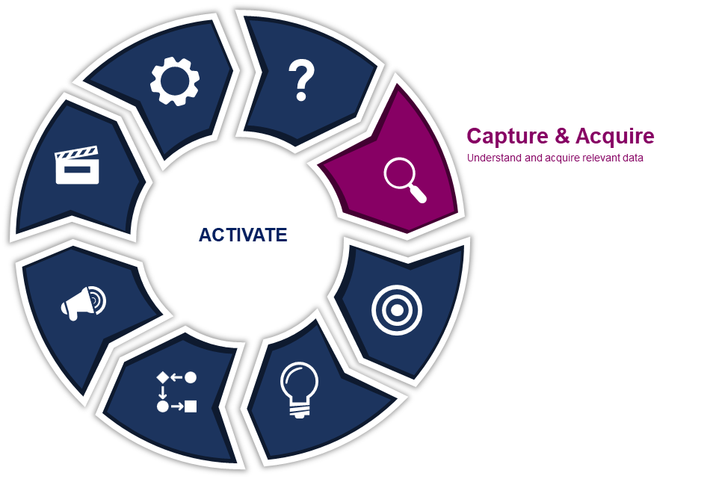
Capture & Acquire
Ensure Systemic Data Collection
Prioritize Data Quality
Filter Out Noise
Ensure Data Context

Slide 16
Ensure Systemic Data Collection
Key Dimensions of Systemic Data Collection
Data Format
Data Origin
Time-based Data
Data Purpose
Structured vs Unstructured
Quantitative vs Qualitative
Transactional vs Behavior
Aggregated vs Granular
Internal vs External
Primary vs Secondary
Manually Collected vs Automated Collection
Real-Time vs Historical
Frequent vs Infrequent
Operational vs Strategic

Slide 17
Prioritize Data Quality
Is the Data Valid?
Is the Data Timely?
Is the Data Reliable?
Data & Insights
Is the Data Ethical?
Is the Data Relevant?
Is the Data Impactful?

Slide 18
Filter Out Noise
Signal
Represents the information you want to leverage, among a sea of data and information
Noise
Represents all the other information, which distracts from the relevant information

Slide 19
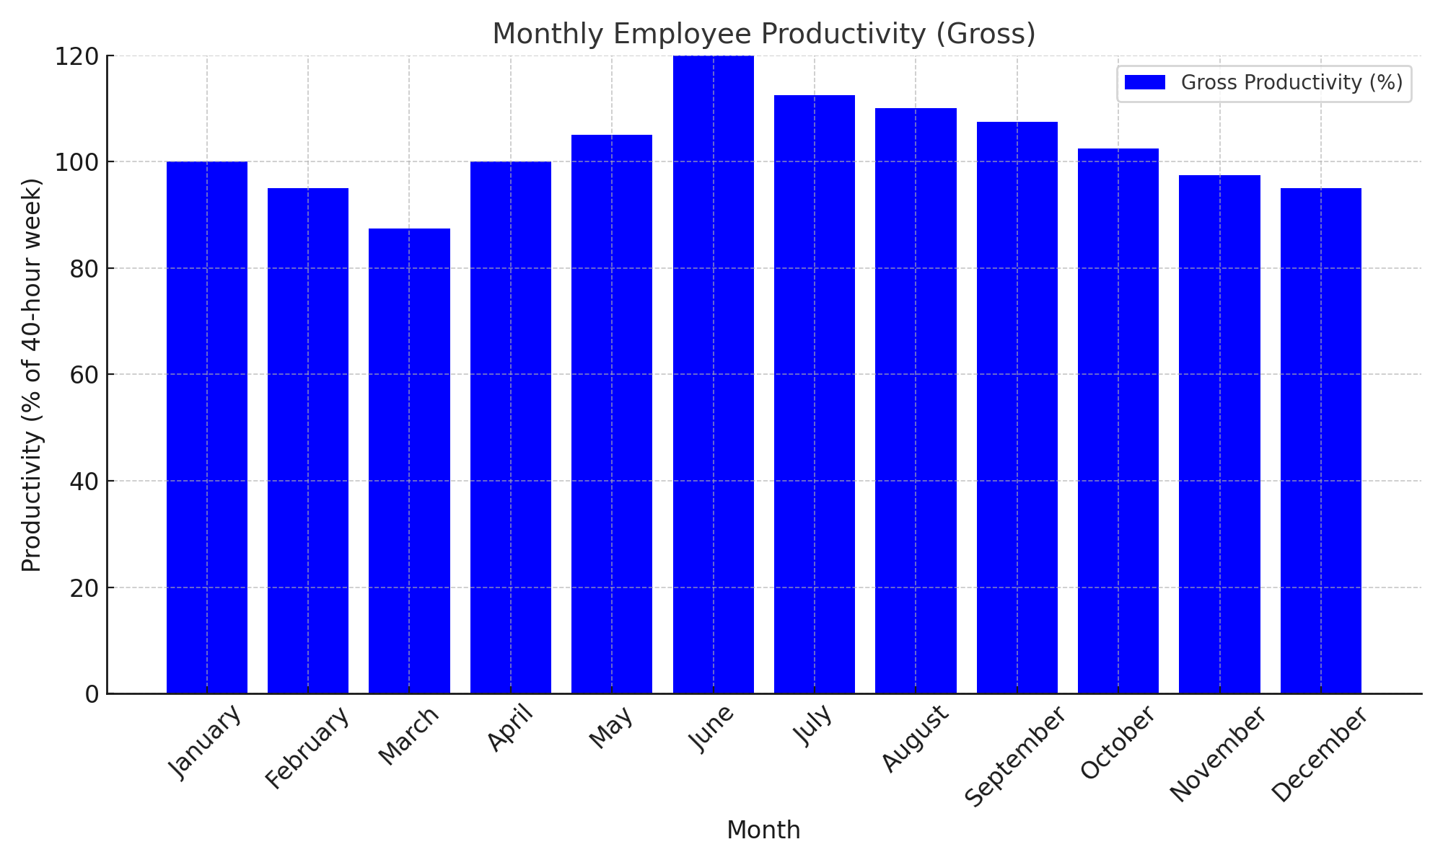
Filter Out Noise - Example
Context
Company managing a remote and hybrid workforce
Focus on evaluating employee productivity across departments
Goal
Understand true productivity levels and trends
Adjust for noise factors to focus on meaningful signals
Signal vs. Noise
Signal Tasks completed per employee per month
Noise Factors
Variations due to external factors (e.g., holidays, unplanned absences)
Differences in team workload distribution
Impact of temporary training or onboarding activities

Slide 20
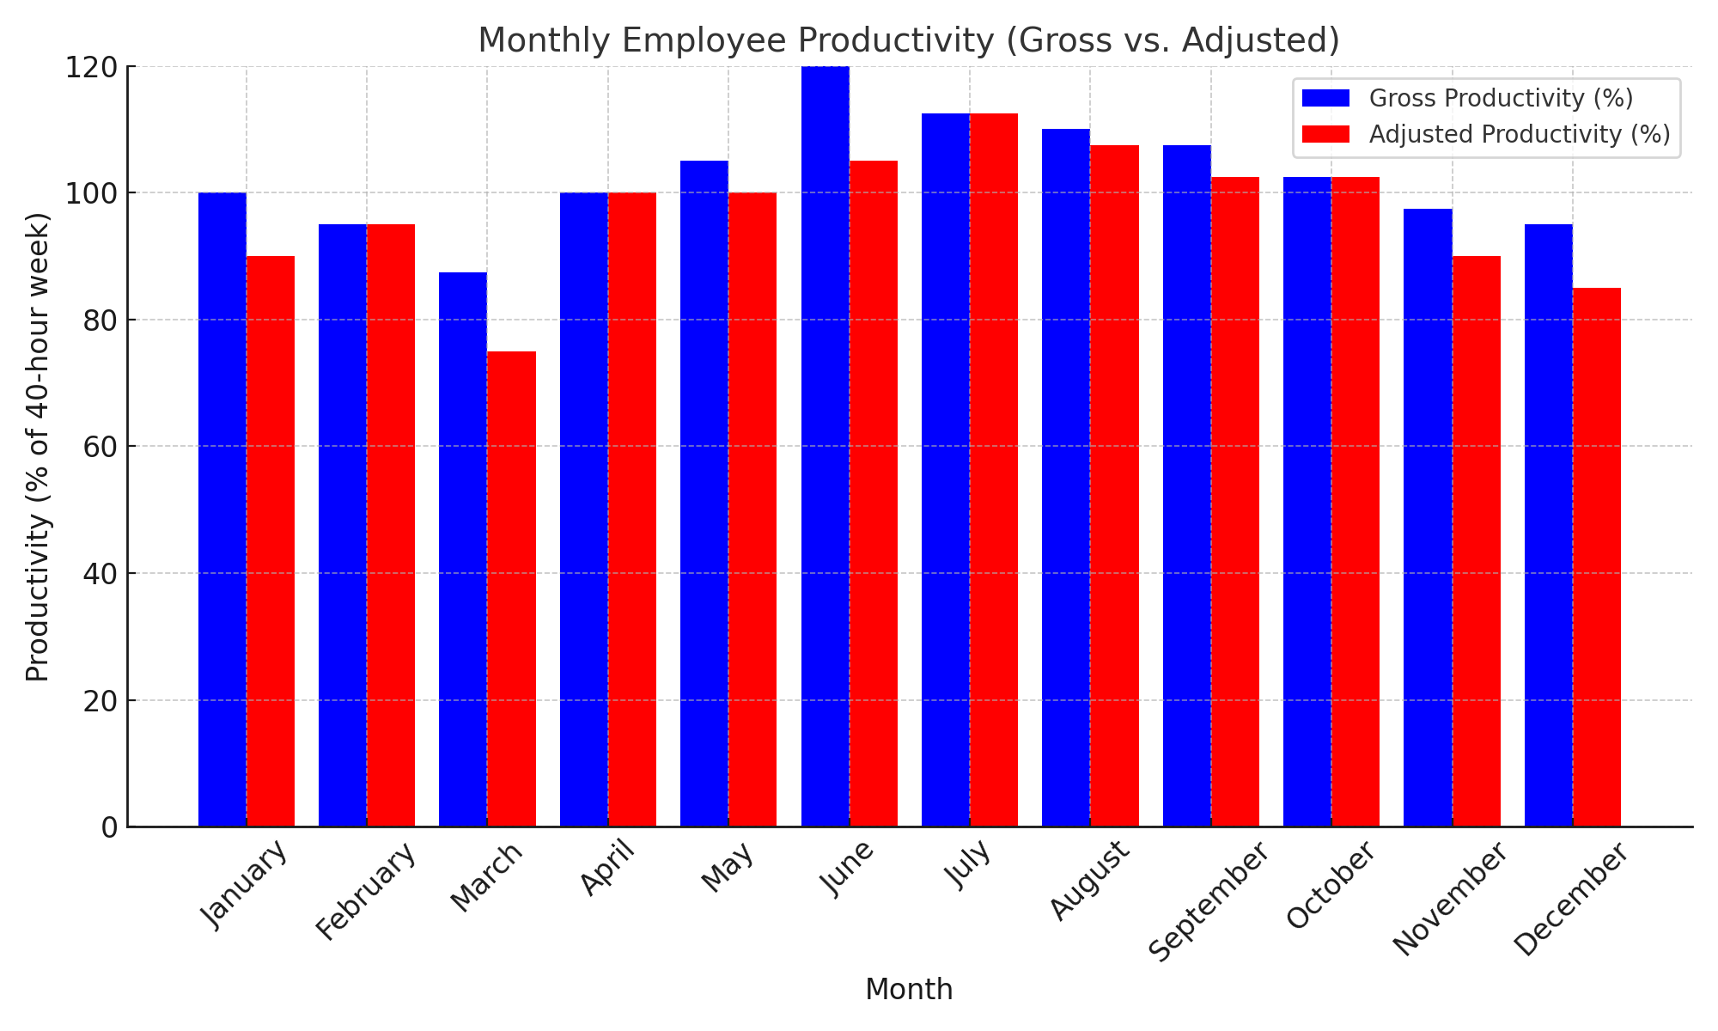
Filter Out Noise - Example
Context
Company managing a remote and hybrid workforce
Focus on evaluating employee productivity across departments
Goal
Understand true productivity levels and trends
Adjust for noise factors to focus on meaningful signals
Signal vs. Noise
Signal Tasks completed per employee per month
Noise Factors
Onboarding or absences
Smoothing out seasonal spikes/dips (e.g., June spike adjusted for additional hours worked)

Slide 21
Breakout Activity – Data Quality & Systemic Data Collection
Your group will evaluate a dataset related to employee productivity and
Identify relevant and irrelevant data points for decision-making
Use Data Quality criteria to assess the dataset
Propose additional data points using the Systemic Data Collection dimensions

Slide 22
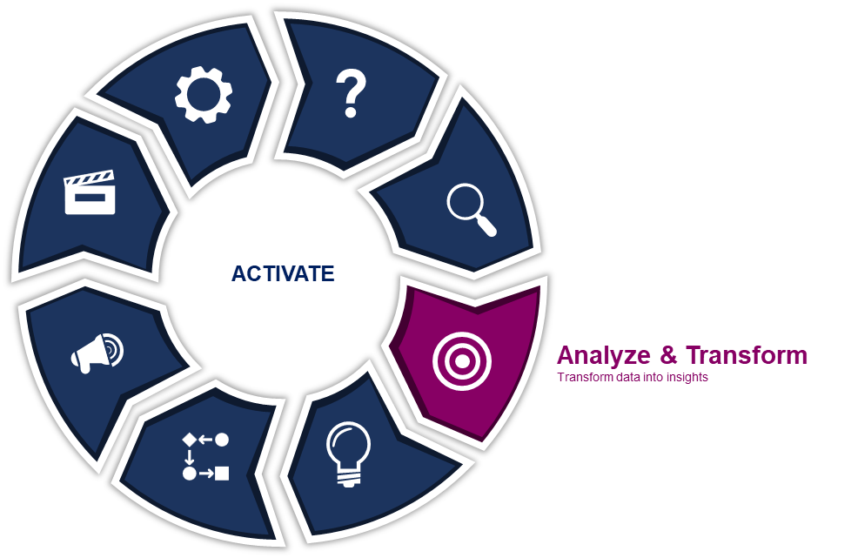
Analyze & Transform for Data Consumers
Data Preparation
Review and Contextualize the Data
Data Analysis
Form Insights

Slide 23
Analytical Thinking Characteristics
Pattern Recognition
Data Segmentation and Classification
Comparison and Benchmarking
Data Exploration
Exploratory Data Analysis
Identifying Outliers
Analyzing Distributions
Spotting Trends
Trend Analysis
Correlation Analysis
Time Series Analysis
Segmentation
Clustering
Classification
Comparing Categories
Benchmarking
Variance Analysis
Data Manipulation and Transformation
Hypothesis Testing and Validation
Decision Support
Data Cleaning
Data Normalization
Aggregation and Summarization
Formulating Hypothesis
A/B Testing
Statistical Significance
Prescriptive Analytics
Scenario and What-if Analysis
Forecasting and Predictive Analytics

Slide 24
Analytics Framework
Value
Prescriptive
Anticipating what will happen, when it will happen, and why it will happen
Predictive
Analyzing current events to predict future events
Diagnostic
Looking for previously unknown relationships in data
Descriptive
Quantitatively describing data
Complexity

Slide 25
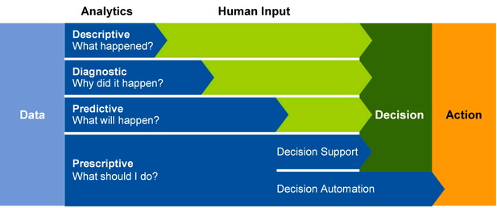
Analytics Framework for Data-Informed Decision-Making
Source: Gartner

Slide 26
Example – Personal Healthcare
Descriptive
Diagnostic
Predictive
Prescriptive
What Happened?
Why did it happen?
What will happen?
What action to take?
Vitals
If symptoms or vitals are off, run tests and ask questions to see root cause of that problem
Based off vitals predict health outcome
Prescribe medication or change in lifestyle

Slide 27
Example – Employee Productivity
Descriptive
Diagnostic
Predictive
Prescriptive
What Happened?
Why did it happen?
What will happen?
What action to take?
How many hours did employees work last week?
Why did productivity drop in Team A last month?
Which teams are at risk of burnout based on current workload trends?
What changes in workload distribution can help improve productivity without burnout?

Slide 28
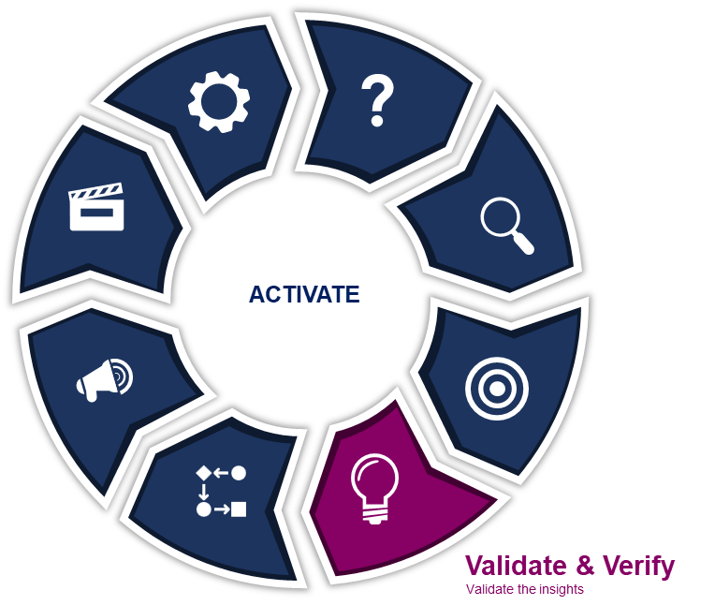
Validate & Verify
Insight Quality Validation
Check Reasoning, Bias, and Fallacies
Identify Alternative Solutions
Perspectives Check
Evaluate Your Assumptions

Slide 29
Check Reasoning, Bias, Fallacies
Reasoning
Bias
Fallacies
Reasoning challenges arise from faulty or incomplete thought processes, leading to incorrect conclusions or misinterpretations of data due to gaps in logical analysis
Bias challenges stem from cognitive shortcuts and personal inclinations that distort how data is interpreted
Fallacies involve flawed logic or deceptive reasoning when analyzing and interpreting data or drawing conclusions

Slide 30
Interactive Activity
A company transitioned to a hybrid work model. Leadership was concerned about productivity and wanted to evaluate the impact of the change. Initial data showed an increase in reported idle time, raising alarms about whether remote work was negatively impacting productivity.
Did remote work reduce overall productivity?

Slide 31
Interactive Activity
In 2020 (remote), the idle time per week per employee went up from 3 hours in 2019 (pre-remote) to 7 hours
Idle time increased
Was employee productivity declining?
Data
Information
Knowledge
Understanding
Year | Time Idle per week
2019 | 3
2020 | 7
Idle time increased by 67% after the remote work transition
Management concluded that remote work caused employees to work less efficiently
The conclusion was that remote work reduced productivity and caused disengagement

Slide 32
Interactive Activity
Upon further analysis, it was discovered that meeting time decreased significantly, providing more unstructured time for focused work
Data
Information
Knowledge
Understanding
Year | Time Idle per week
2019 | 3
2020 | 7
Idle time increased by 133% after the remote work transition
Idle time wasn’t unproductive; employees had more time for deep work
Remote work reduced unnecessary meetings, allowing employees to complete more tasks.
Remote work led to more focused productivity, despite the increase in idle time. The hybrid model is actually improving overall efficiency
Year | Avg Weekly Meetings per Employee
2019 | 15
2020 | 8
Year | Completed Deliverables
2019 | 6
2020 | 8

Slide 33
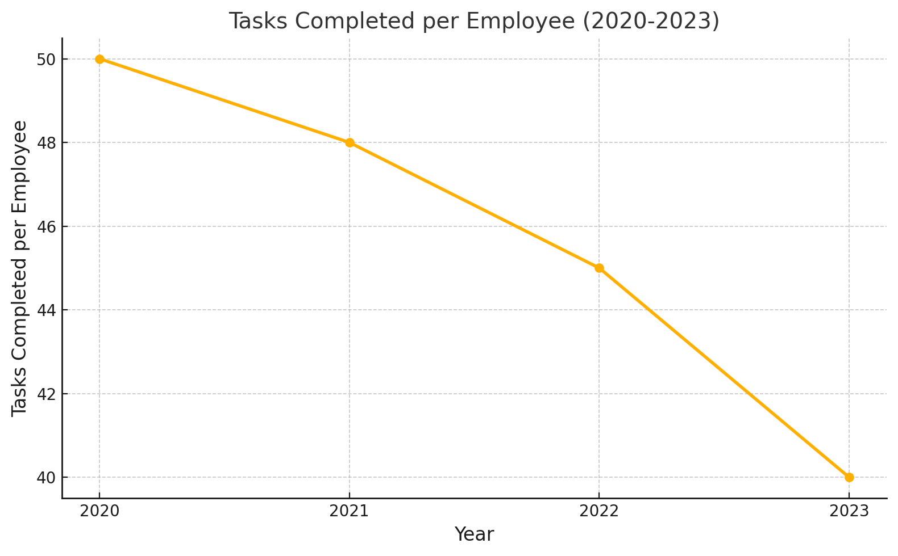
Interactive Activity
Based off the visualization below, can we conclude that overall employee productivity is decreasing?
Look at this data visualization. There was 10 less tasks completed on average per employee in 2023 compared to 2020

Slide 34
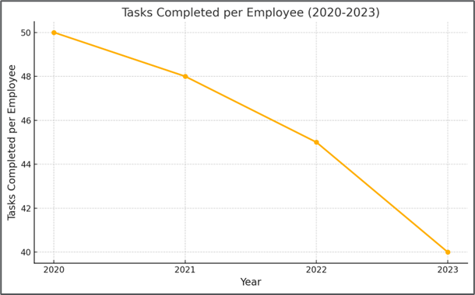
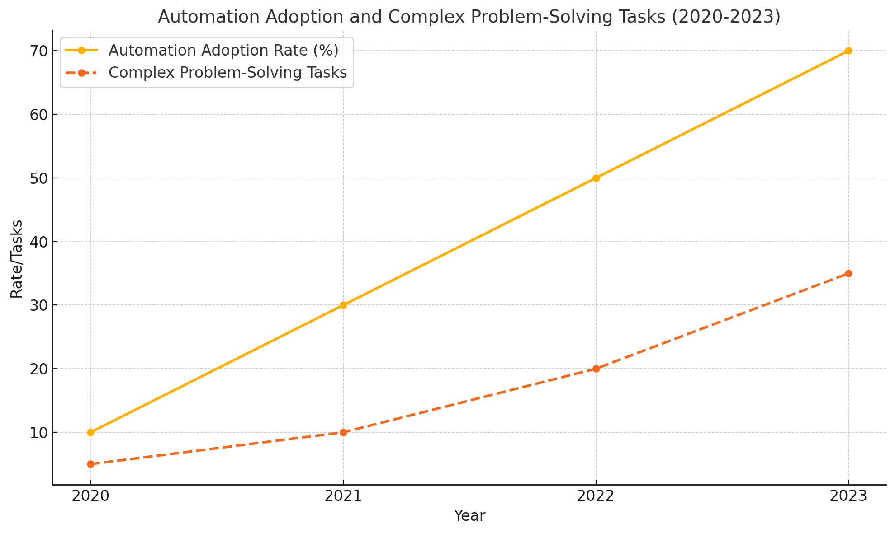
Interactive Activity
Based off the visualization below, can we conclude that overall employee productivity is decreasing?

Slide 35
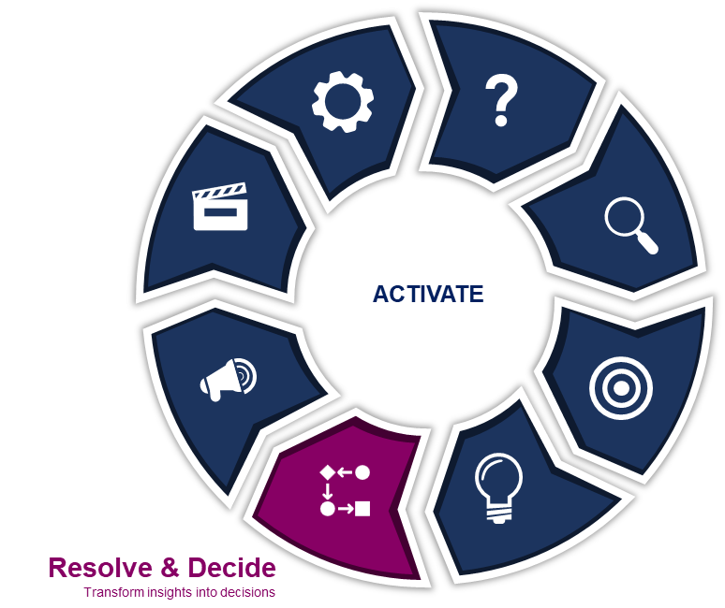
Resolve & Decide
Generate Options
Evaluate Options Against Decision Criteria
Weigh Risks and Uncertainty
Assess Org Readiness
Make Final Decision

Slide 36
Interactive Activity
In News
In Business
Homeless shelters perpetuate homelessness
Get tough prison sentences fail to reduce fear of violent crime
Let’s buy a tool, that will solve it!
Offering bonuses for high performance reduces employee engagement
Food aid increases starvation
Job training programs fall short of increasing employment
I am just responsible and focusing on sales, that task does not relate to onboarding
Drug busts increase drug-related crime
Increasing customer discounts eventually leads to less customers and revenue
What do these stories all have in common?

Slide 37
Understanding Different Layers to a Problem
Thinking Systemically
WHAT HAPPENED?
EVENTS
REACT
WHAT HAPPENED BEFORE?
PATTERNS/TRENDS
ANTICIPATE
WHAT LED TO THE PATTERNS?
UNDERLYING STRUCTURES
DESIGN / REFORM
WHAT ASSUMPTIONS, BELIEFS?
MENTAL MODELS
TRANSFORM
Delving below the surface of events helps us see a bigger picture of how a system actually works. With this understanding we can make choices about how best to intervene to effect change such as modifying our mental models

Slide 38
The Data-Driven Decision Activity
The Data
The Metrics
Employees who engage in weekly professional development programs:
25% higher task completion rates
15% higher employee satisfaction scores
Analysis covers 1 year across all departments
Engaged Employees' Weekly Task Completion Rate: 50 tasks/week
Non-Engaged Employees' Weekly Task Completion Rate: 40 tasks/week
Engaged Employees' Satisfaction: 90%
Non-Engaged Employees' Satisfaction: 75%
The Proposal
“Let’s mandate weekly professional development sessions for all employees to boost productivity and morale. The data clearly shows this will lead to better performance and satisfaction.”
Based on this data, what are your initial thoughts about the proposal to mandate weekly professional development sessions for all employees?

Slide 39
The Data-Driven Decision Activity – Additional Context & Risks
Critical Factors
Professional development requires 2 hours/week per employee
Workload redistribution may lead to task delays
Only 60% of employees have expressed interest in professional development
Employees not engaged in development currently report higher focus on specialized tasks
Departments with complex workflows have reported 10% lower performance during mandatory training pilot programs
Competitor trends. Growth in on-demand microlearning instead of weekly sessions
How does this additional information change your thinking?

Slide 40
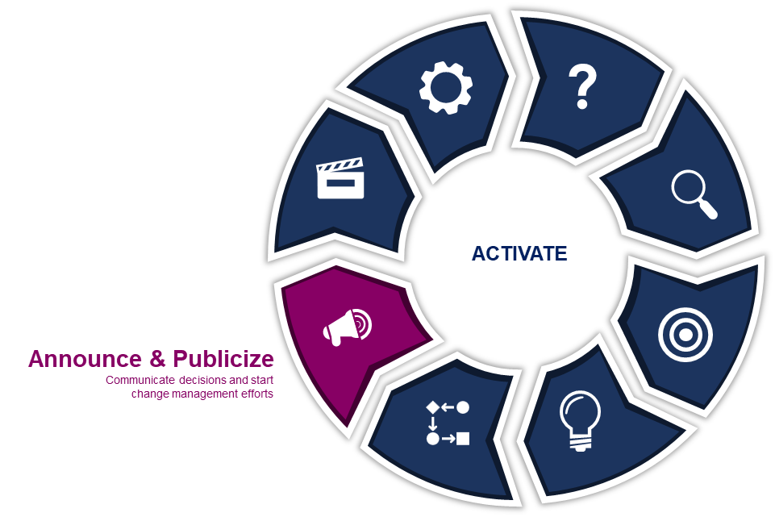
Announce & Market
Stakeholder Analysis
Craft Clear and Consistent Messaging

Slide 41
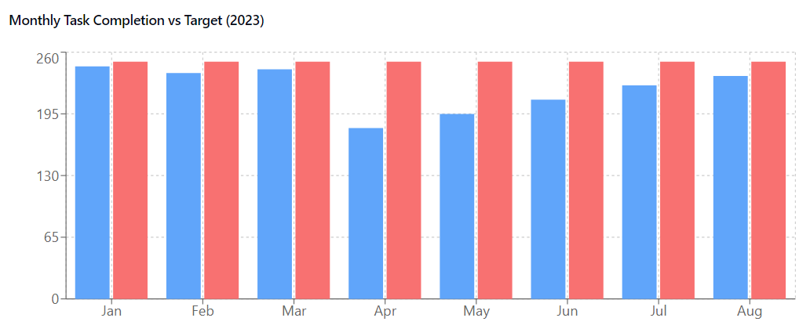
Example – Focus on Insights Over Raw Data

Slide 42
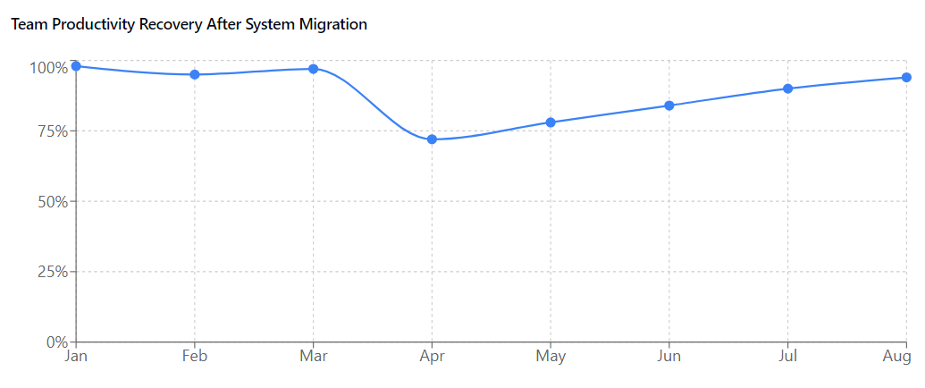
Example – Focus on Insights Over Raw Data

Slide 43
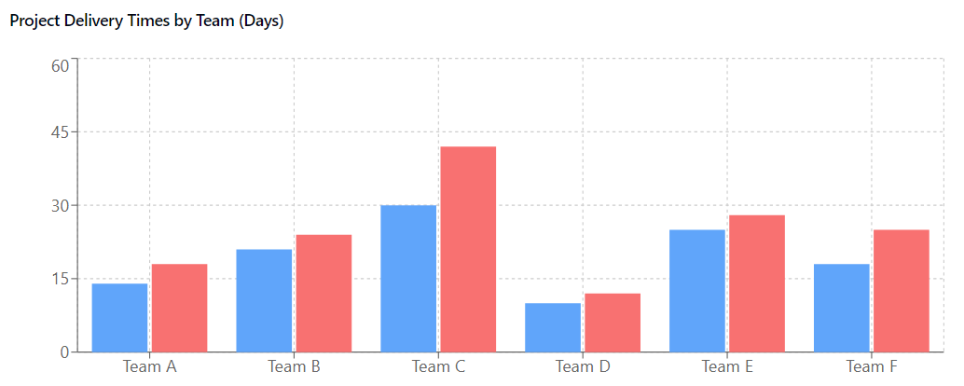
Example – Focus on Insights Over Raw Data

Slide 44
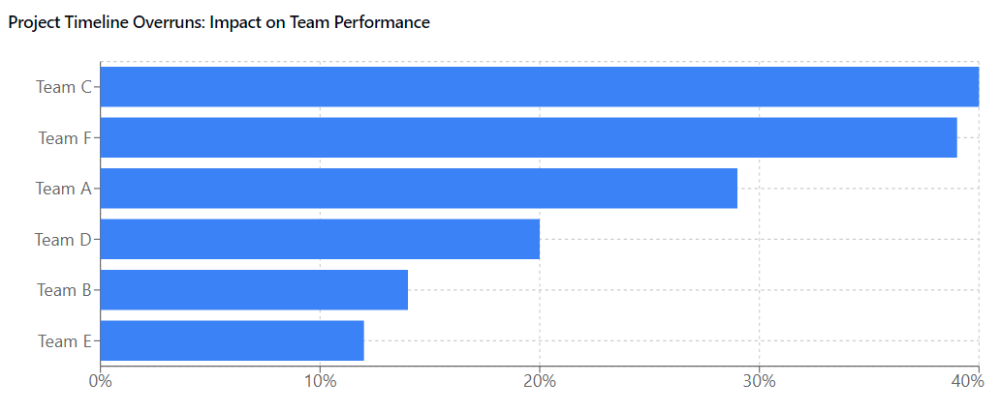
Example – Focus on Insights Over Raw Data

Slide 45
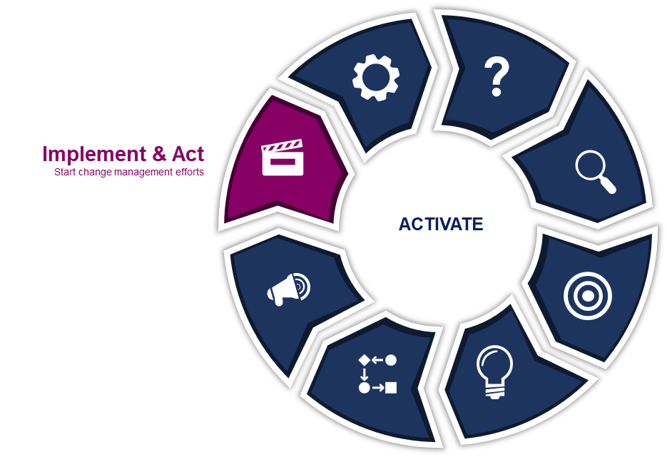
Implement & Act
Develop and Action Plan
Allocate Resources
Execute the Plan
Communicate Progress
Monitor Key Metrics

Slide 46
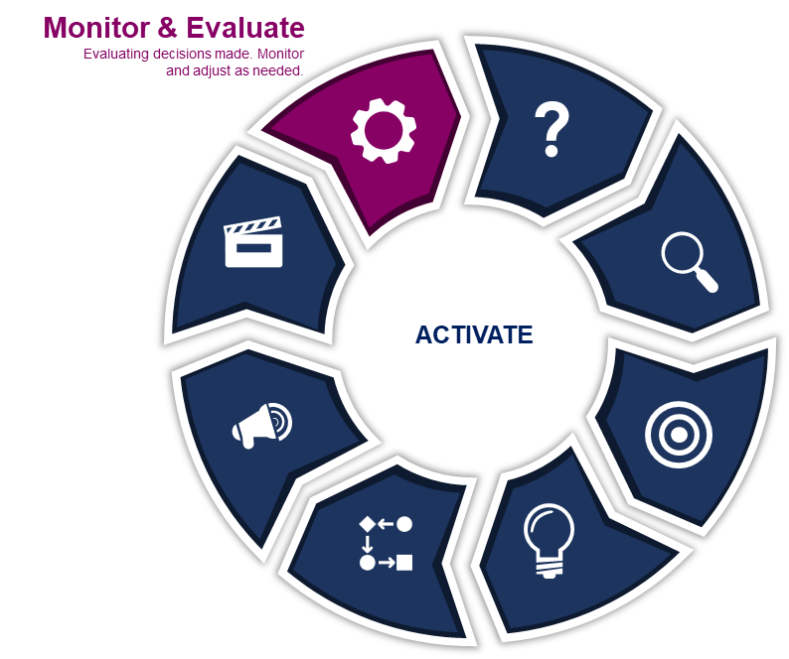
Monitor & Evaluate
Monitor Short-Term and Long-Term Outcomes
Assess the Decision-Making Process
Adjust and Refine for Continuous Improvement

Slide 47
Assess the Decision-Making Process
A successful outcome despite a flawed process
A failed outcome but a solid process
What risks does this flawed process introduce for future decisions?
How can we strengthen the process to ensure repeated, predictable success?
What external factors or unforeseen challenges led to the failed outcome, despite a solid process?
Is there anything in the environment that needs re-evaluation, or is this a case of bad luck?

Slide 48
Monitor Key Metrics
Measurements, Metrics, and KPIs
Leading vs Lagging Indicators
Measurement Frameworks
Short-term vs Long-term
Continuous Monitoring and Adjustment
Define and track the right performance indicators aligned with your objectives
Balance predictive (leading) and reflective (lagging) KPIs for a full performance view
Use tools like Balanced Scorecard or OKRs to organize and evaluate metrics
Track immediate results and long-term outcomes for sustainable growth
Regularly review metrics and adjust strategies as needed based on performance

Slide 49
Review - Data-Informed Decision-Making Process
Monitor & Evaluate
Ask & Define
Evaluating decisions made. Monitor and adjust as needed.
Identify decisions to be made
?
Capture & Acquire
Implement & Act
Understand and acquire relevant data
Start change management efforts
Data-informed
Decision-making
Analyze & Transform
Announce & Market
Transform data into insights
Communicate decisions and start change management efforts
Resolve & Decide
Validate & Verify
Transform insights into decisions
Validate the insights

Slide 50
Key Takeaways
Systems Thinking
Data Gathering
Analytical
Thinking
Validation & Verification
Decision Making
Implementation & Learning
Consider the Whole System
Capture the Right Metrics
Identify Patterns and Form Hypotheses
Challenge assumptions and validate insights
Balance short- and long-term impacts
Act with agility and adapt based on feedback

Slide 51
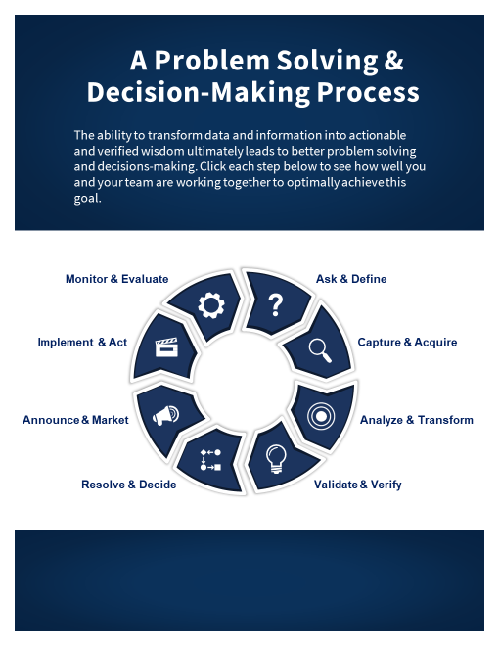
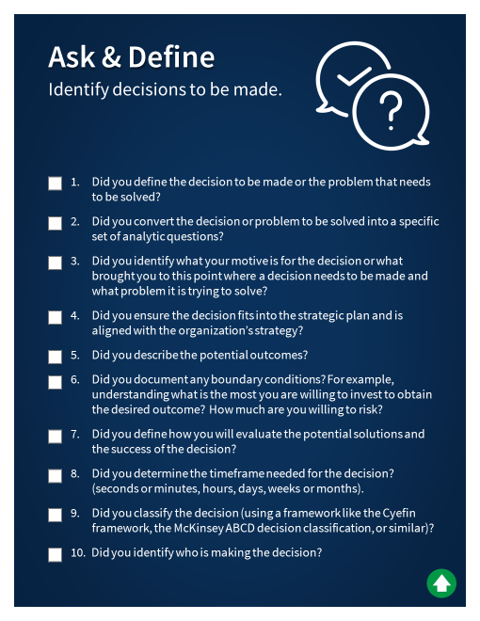
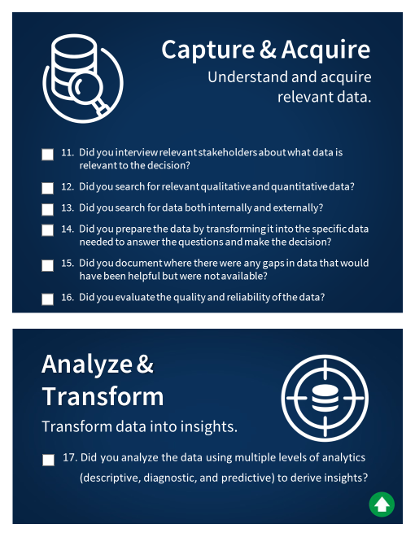
Data-Informed Decision-Making Checklist

Slide 52
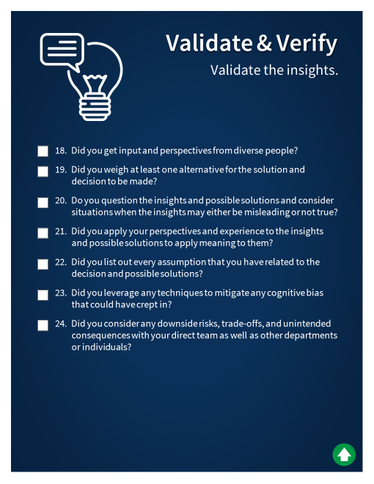
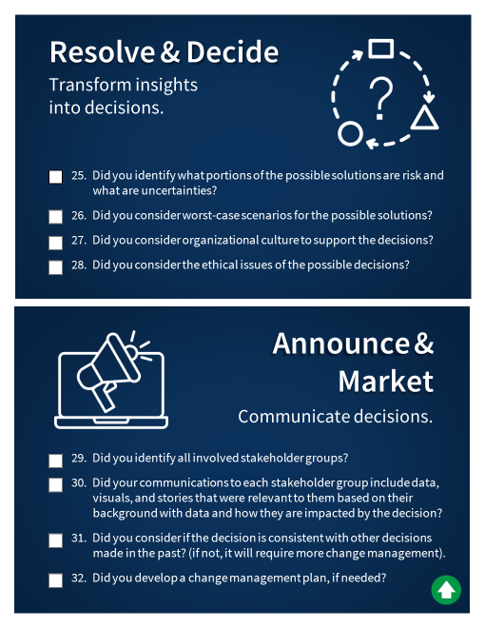
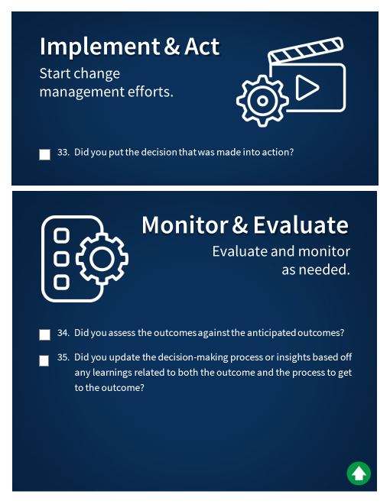
Data-Informed Decision-Making Checklist

